Slide 2
Create a great UX with Blazor
Jimmy Engstrom
@EngstromJimmy

Slide 3
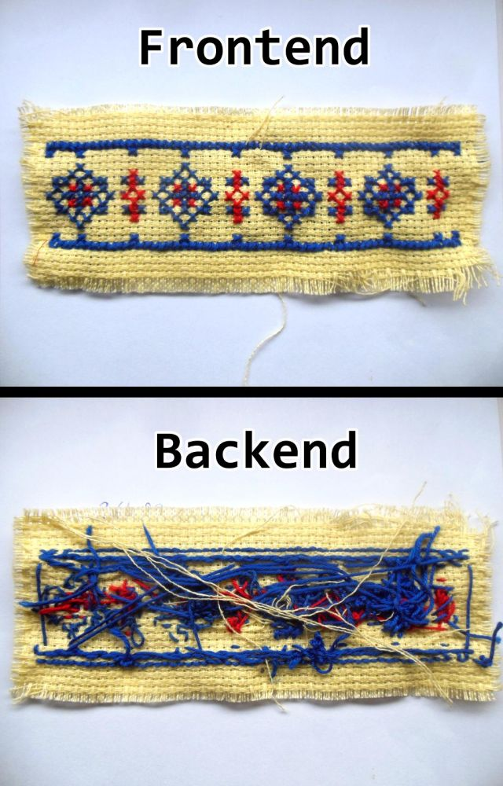
Backend
Frontend

Slide 4


Slide 5
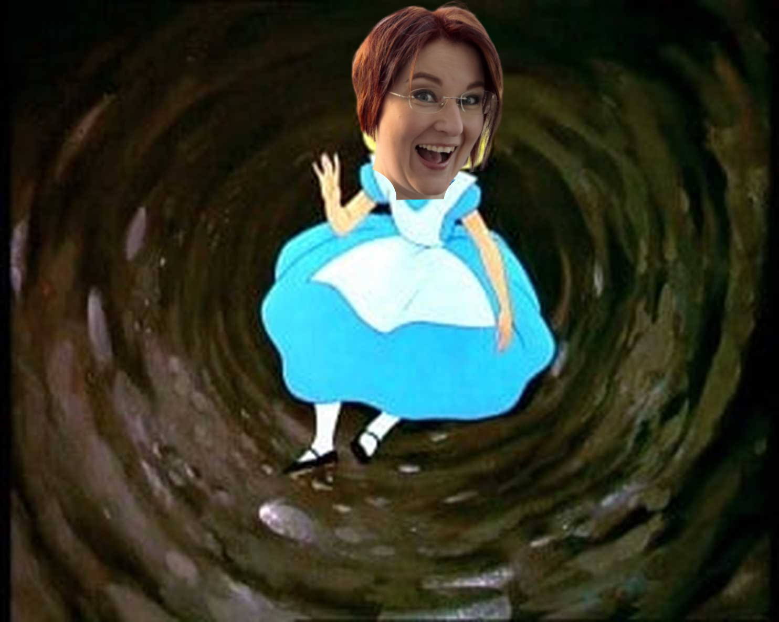

Slide 6




Slide 7
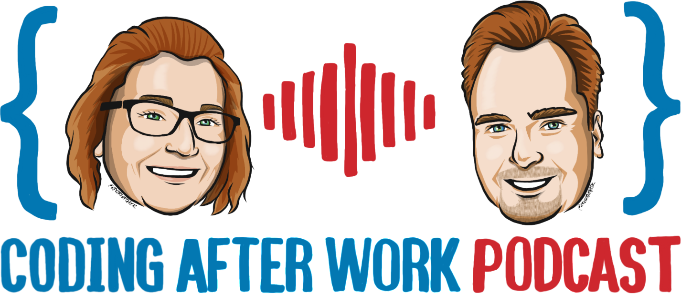

Slide 8
The Brain API

Slide 9
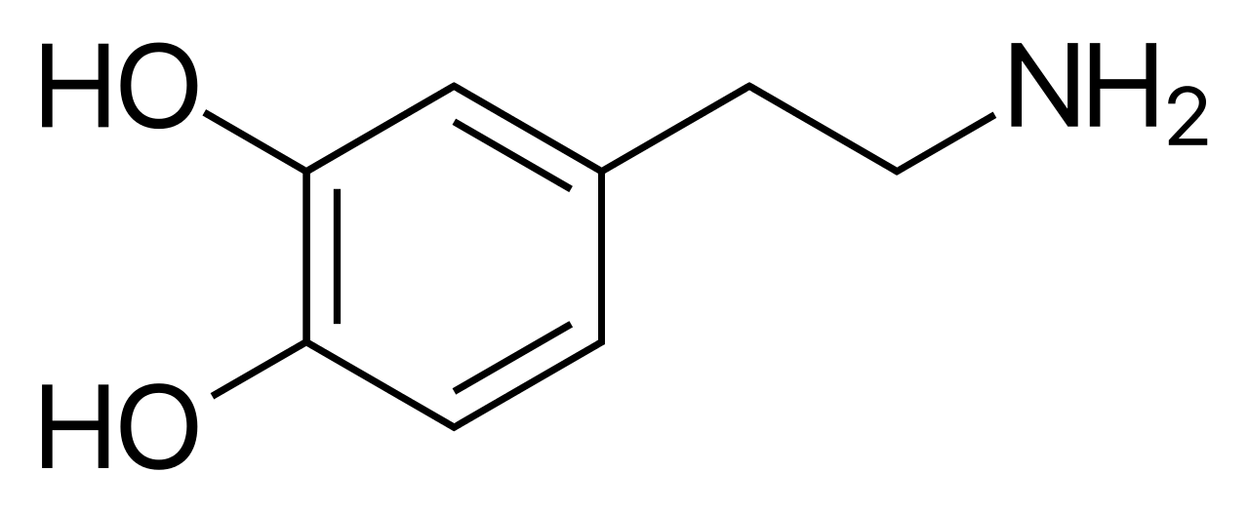
Dopamine
Increase working memory
Motivation
Productivity
Gamification
Reward-motivated behaviour

Slide 10
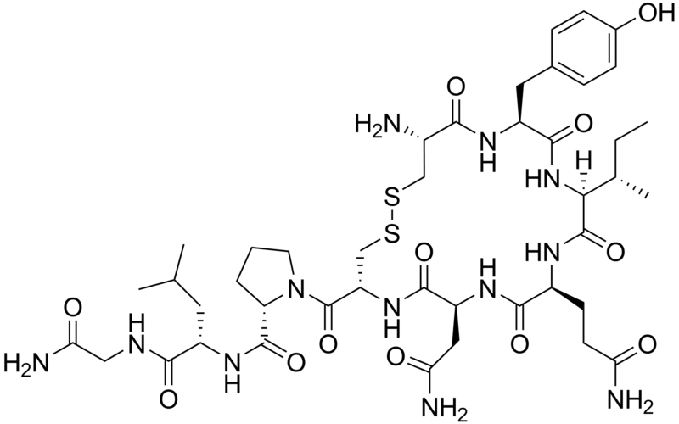
Oxytocin
Grounded
Happy
Mindful
Humanize
Avatars
Connection

Slide 11
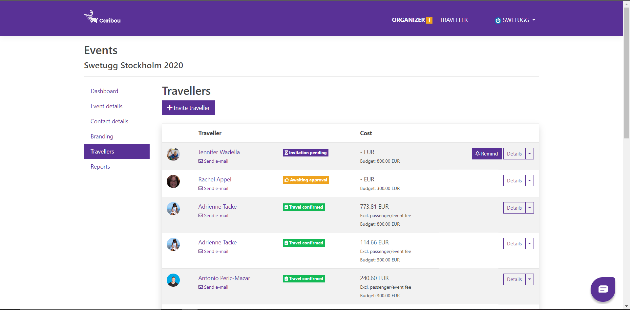
v

Slide 12
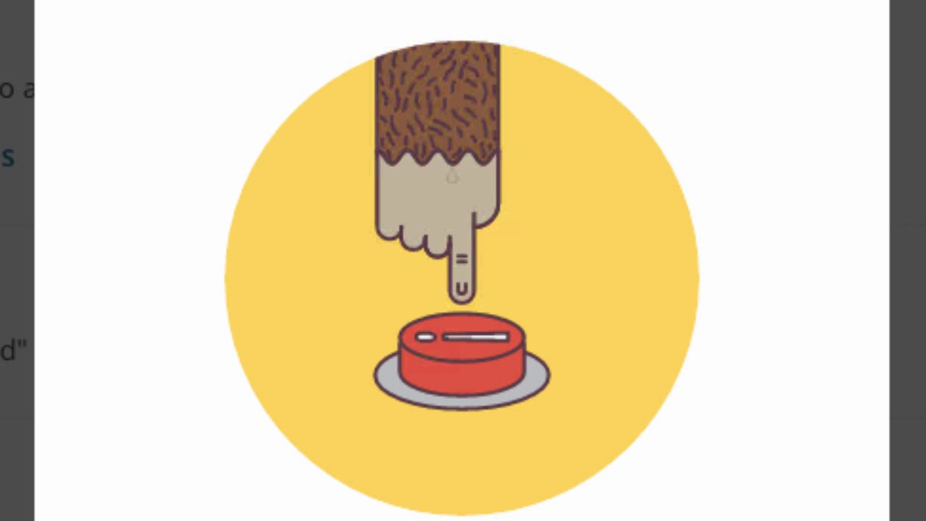
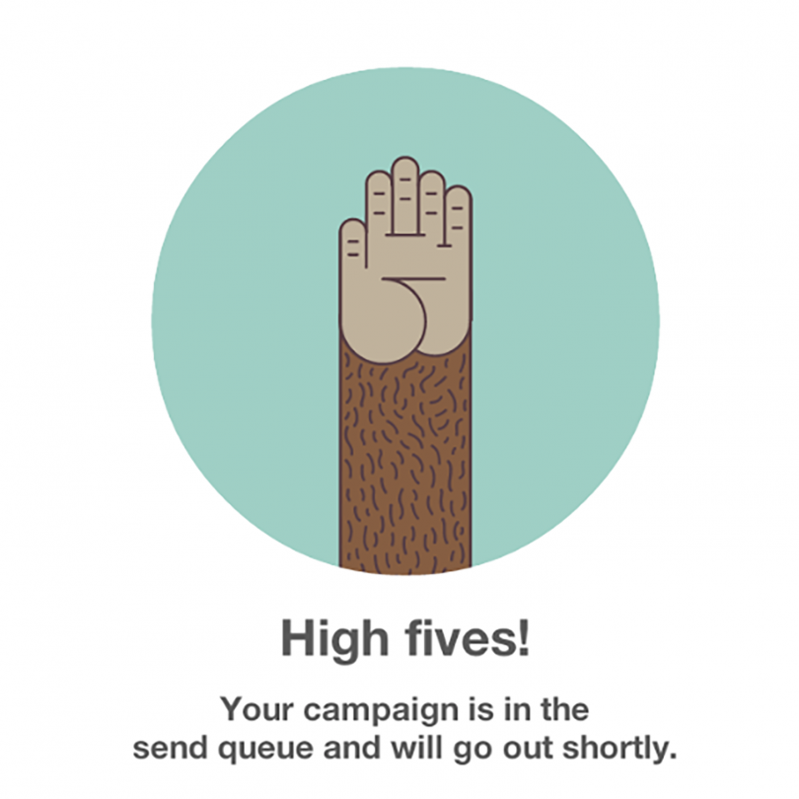

Slide 13


Slide 14
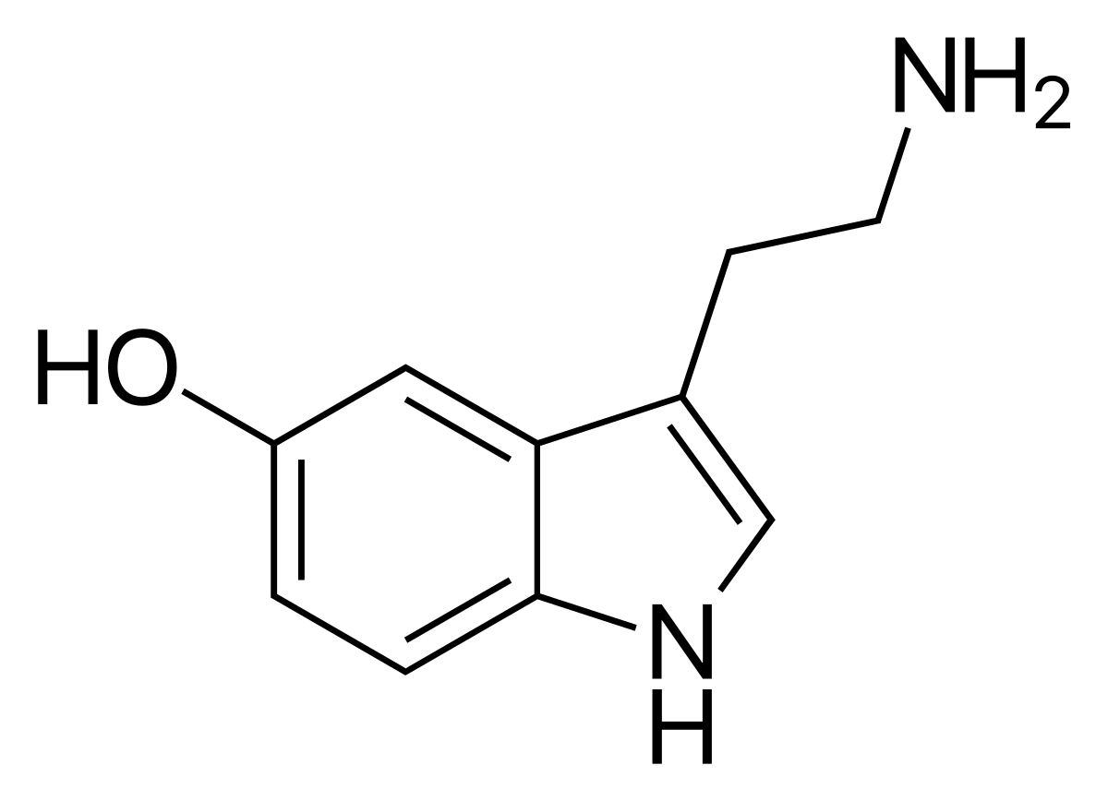
Serotonin
Increase working memory
Sence of belonging
Help mood
Positive events
Gamification

Slide 15
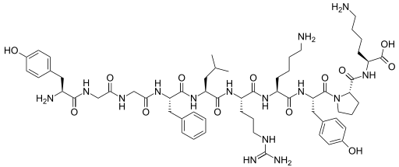
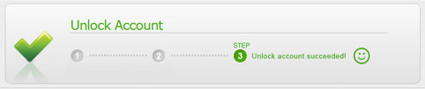
Endorphine
Feeling of satisfaction
Success
Achievement or victory
Gamification
Positive reinforcements

Slide 16
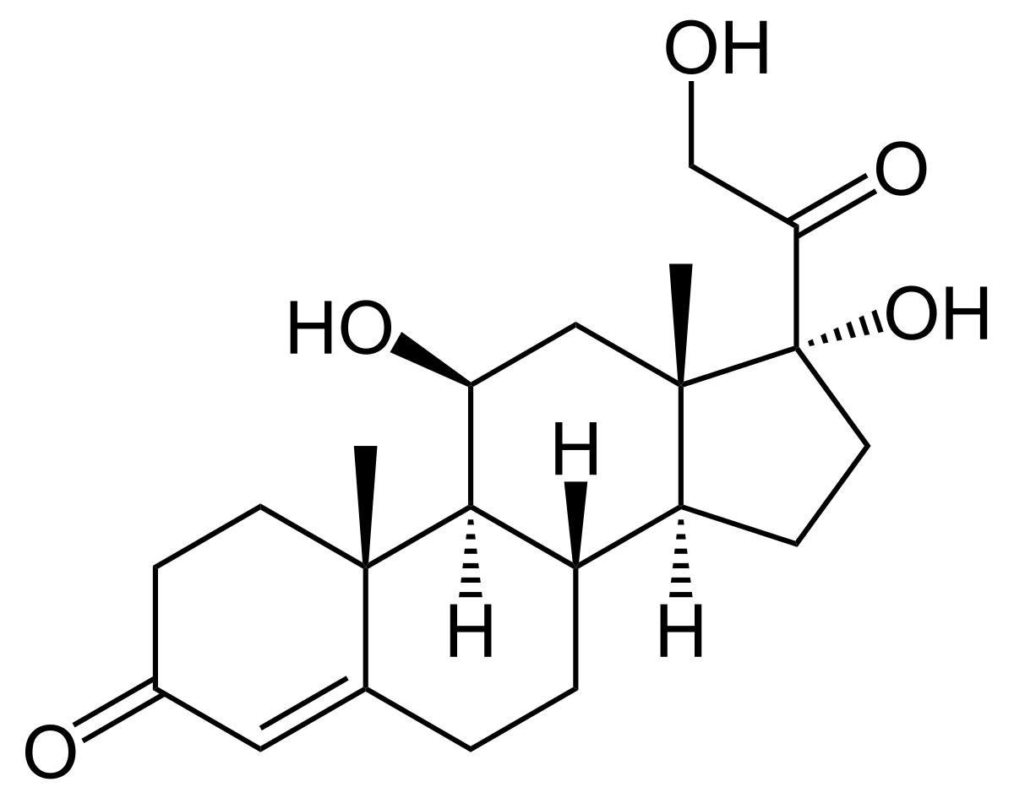
Cortisol
Stress
Overwhelming
Multitasking
Unclear error messages

Slide 17
Scoped CSS

Slide 18
SASS

Slide 19
SASS
Syntactically awesome style sheets

Slide 20
https://getbootstrap.com/

Slide 21
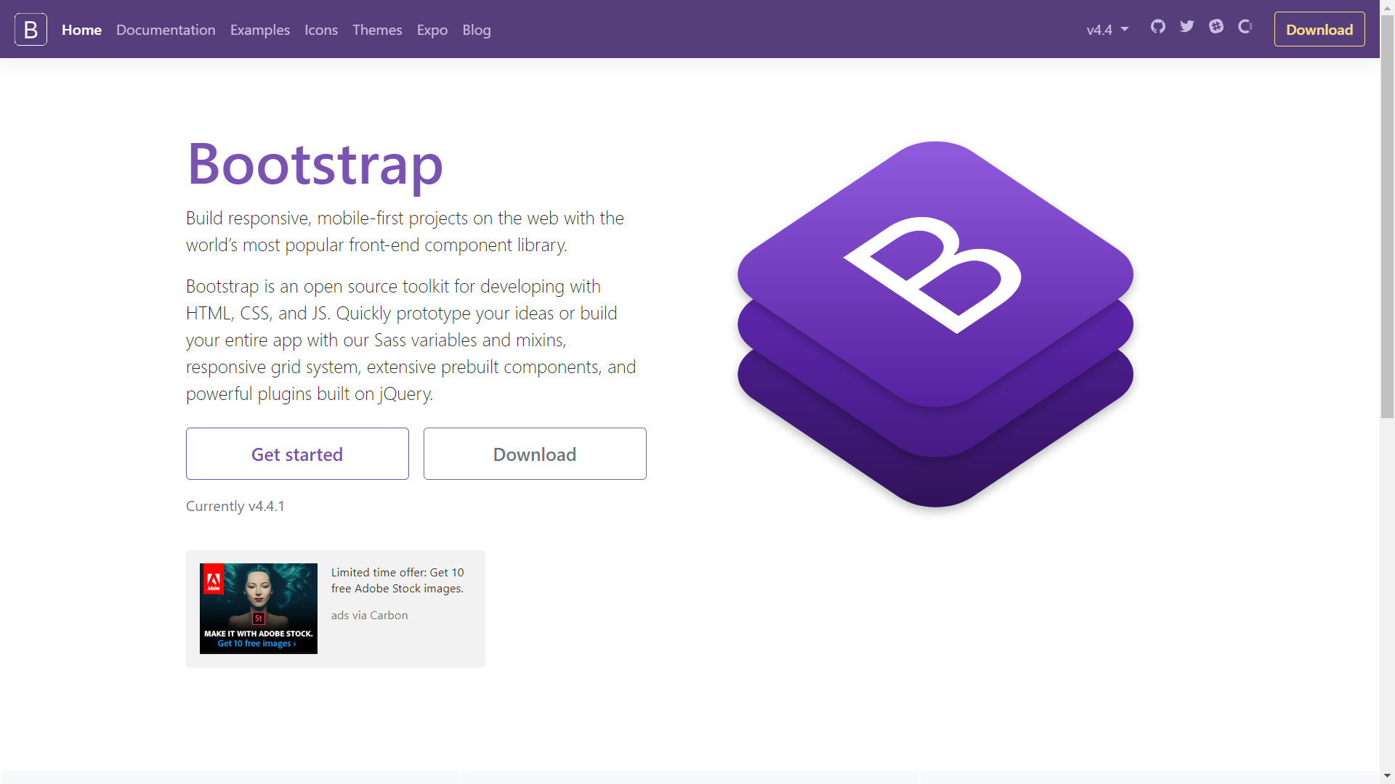

Slide 22
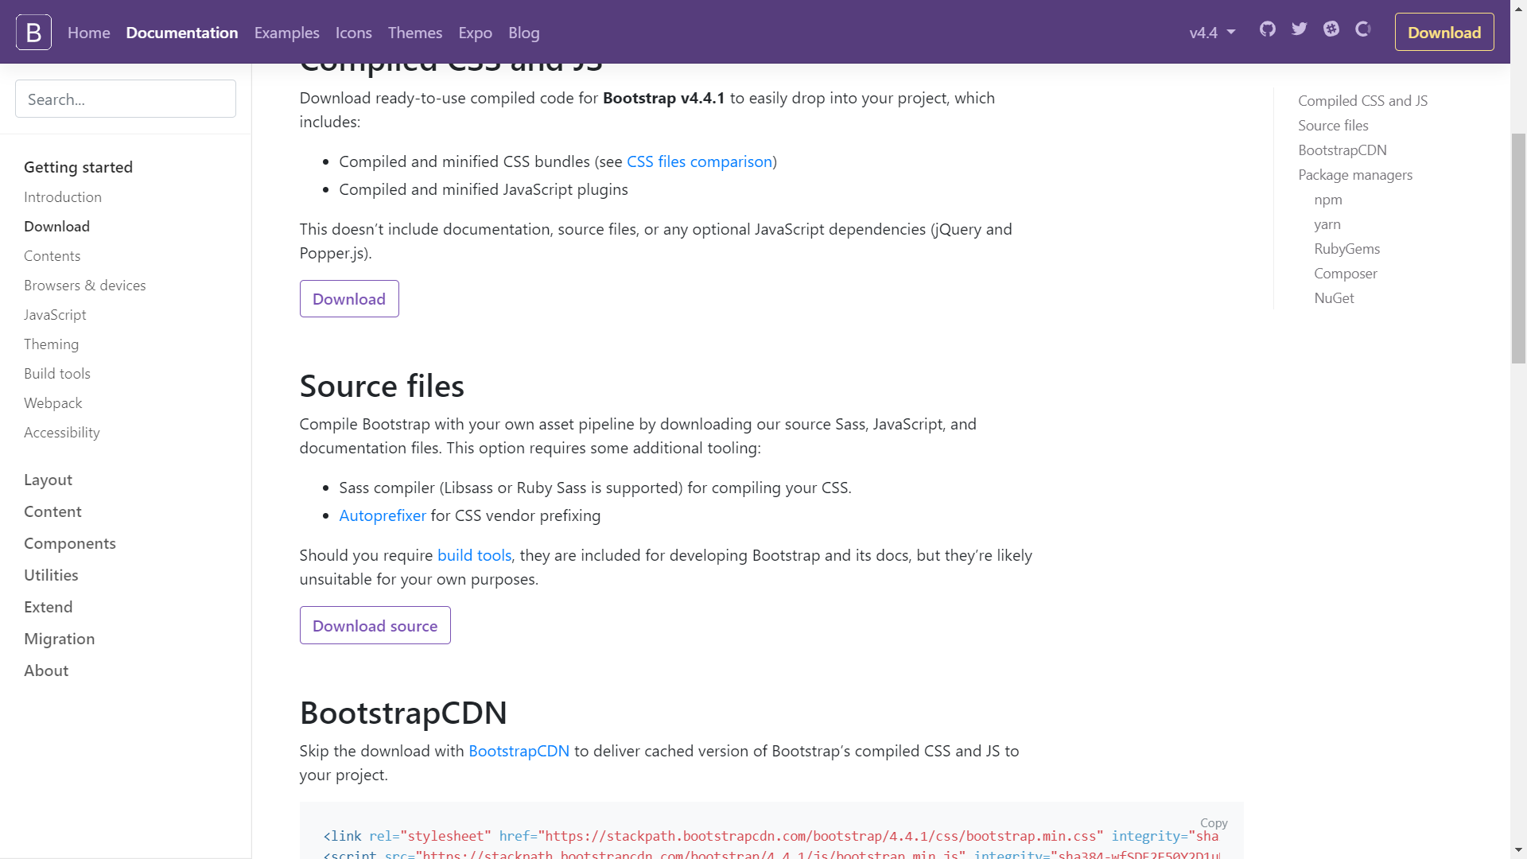

Slide 24
Thank you!
Jimmy@EngstromJimmy.se
Twitter
Name
Blog

